Slide 1
Covid-19 Case Study
Regione Lombardia
SMDS Final project
Valeria Insogna, Roberta Pascale, Anna Pederzani, Thomas Verardo

Slide 2
Outline
Introduction
Exploratory Data Analysis
Model building
Model checking
Model selection
Data prediction
Conclusions

Slide 3
Introduction
Objective → Modeling the trend of the number of hospitalized people in Lombardia during the Covid-19 spreading outbreak and provide forward predictions given the models built
Input dataset → Covid-19 data from the official website of Protezione Civile, Convid-19 Rt data from the Istituto Superiore di Sanità, color of the regions Ondata.it
Variable of interest → totale_ospedalizzati
Time reference → 1st October 2020 - 1st February 2021
Area of interest → Lombardia

Slide 4
Exploratory Data Analysis
Data → 124 observations of 30 variables
3 variables totally missing
note
note_test
note_casi
9 variables missing more than 50% of data
totale_positivi_test_molecolare
totale_positivi_test_antigenico_rapido
codice_nuts_1
codice_nuts_2
tamponi_test_molecolare
tamponi_test_antigenico_rapido
casi_da_sospetto_diagnostico
casi_da_screening
ingressi_terapia_intensiva

Slide 5
Exploratory Data Analysis
11 variables with no missing data
ricoverati_con_sintomi: Hospitalised patients with symptoms.
terapia_intensiva: Intensive Care.
isolamento_domiciliare: Home confinement
totale_positivi: Total amount of current positive cases (Hospitalised patients + Home confinement).
variazione_totale_positivi: New amount of current positive cases (totale_positivi current day - totale_positivi previous day).
nuovi_positivi: New amount of current positive cases (totale_casi current day - totale_casi previous day).
dimessi_guariti: Recovered (cumulative).
deceduti: Deaths (cumulative).
totale_casi: Total amount of positive cases (cumulative).
tamponi: Tests performed (cumulative).
casi_testati: Total number of people tested (cumulative).

Slide 6
Exploratory Data Analysis
Cumulative variables have been converted per-day
dimessi_guariti_per_day
deceduti_per_day
casi_testati_per_day
totale_casi_per_day
tamponi_per_day
Three extra covariates have been added to the original dataset
color of the region
rt_positive
dummy variable indicating if the peak has already been reached

Slide 7
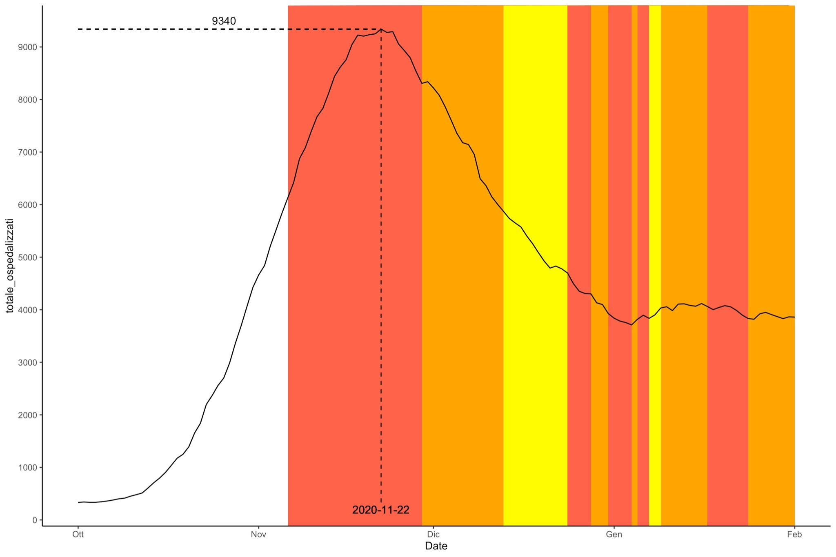
Exploratory Data Analysis
Number of hospitalized people in Lombardia per day from the 1st October 2020 to the 1st February 2021

Slide 8
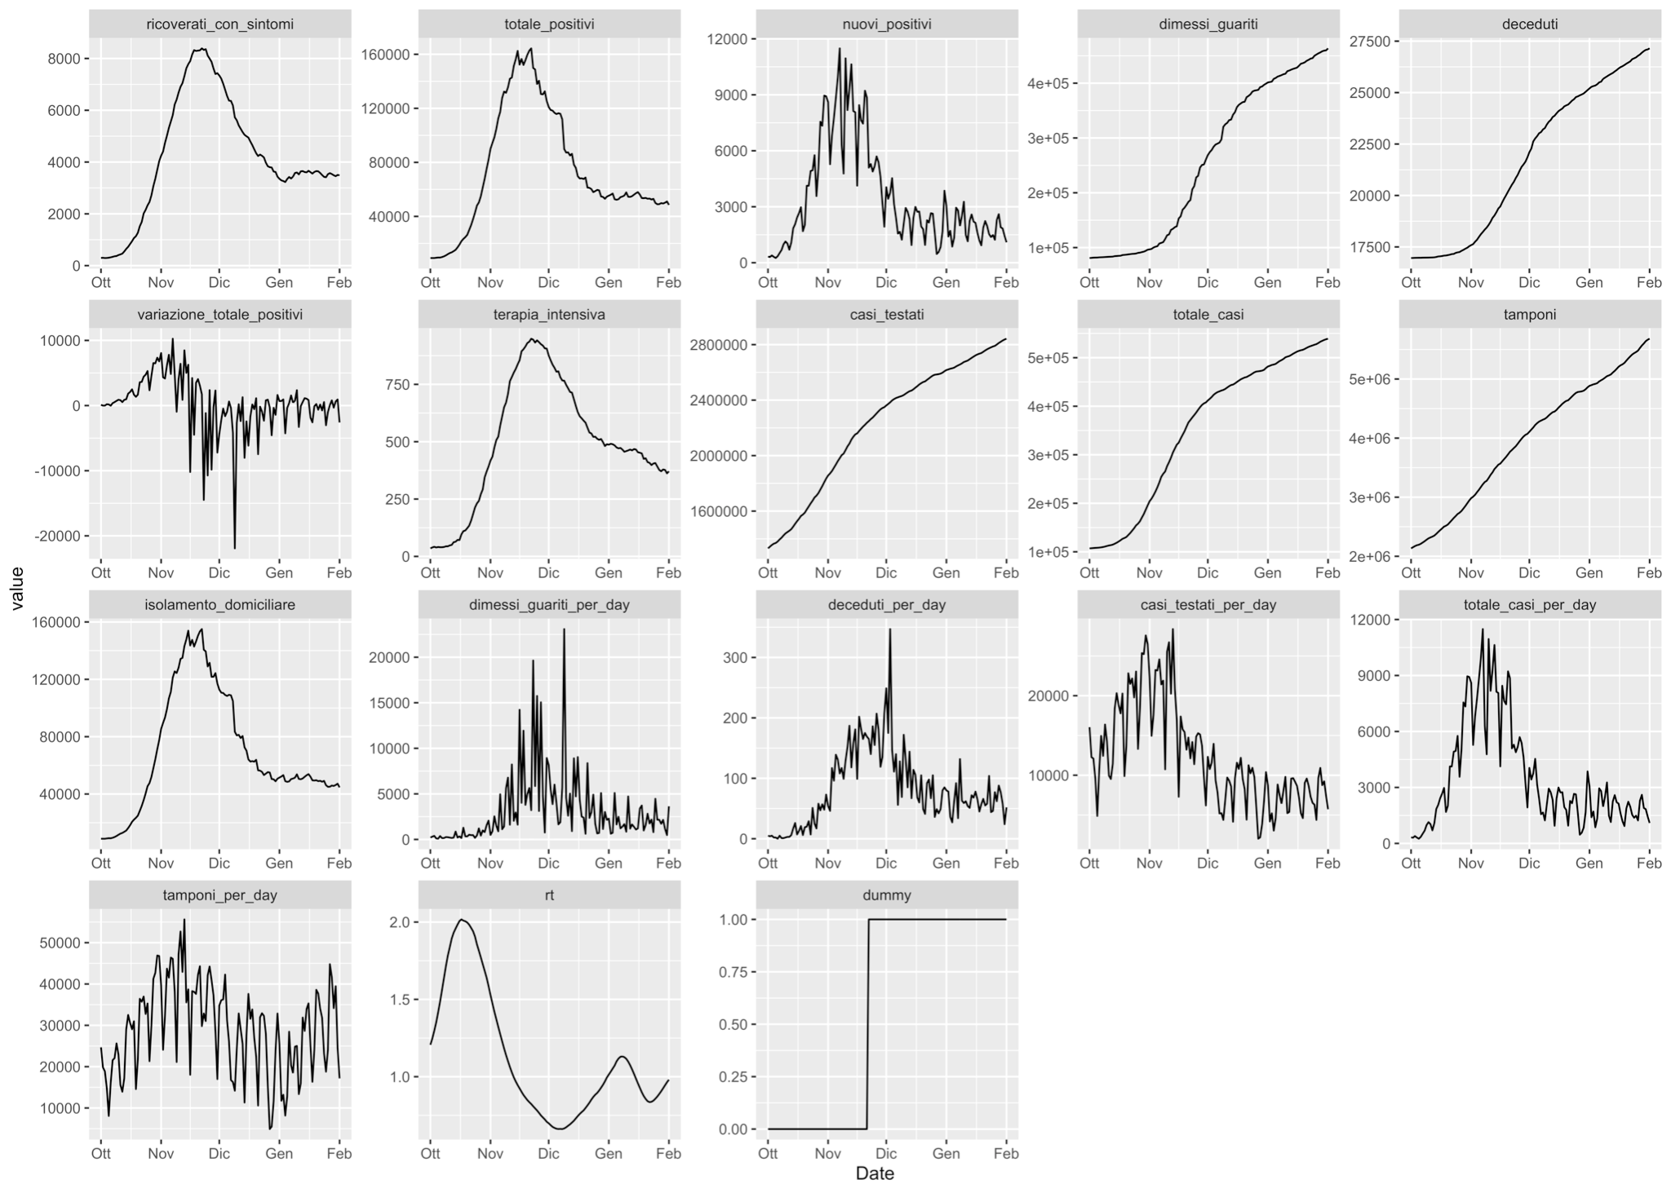
Exploratory Data Analysis
Distribution of the covariates overtime

Slide 9
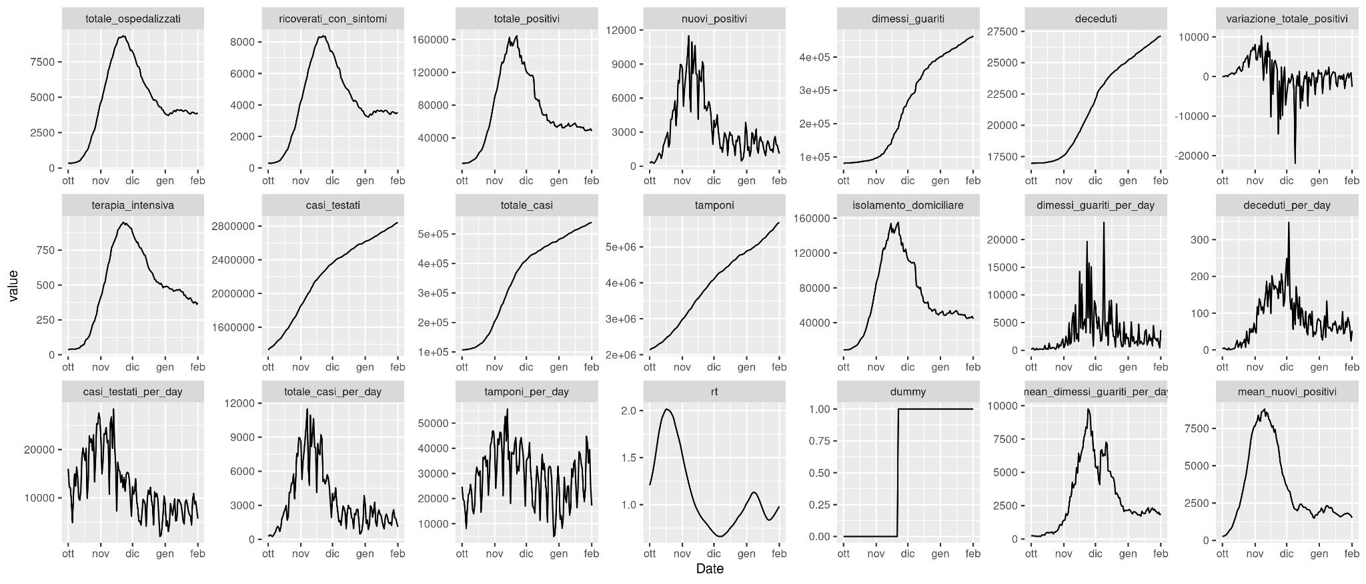
Exploratory Data Analysis

Slide 10
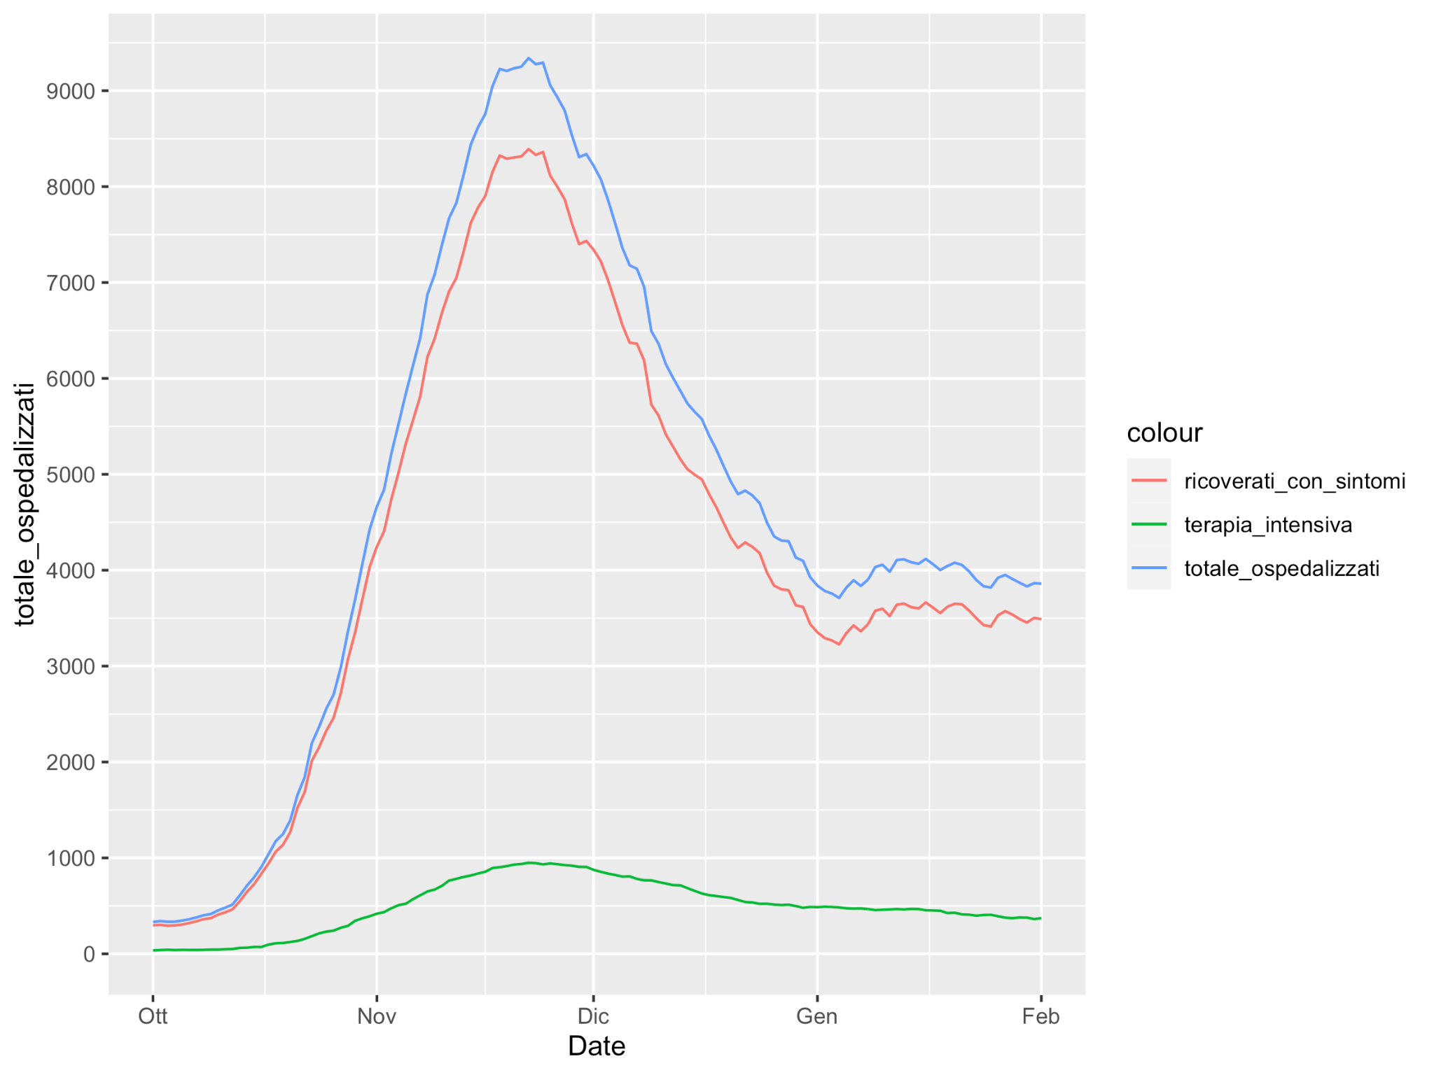
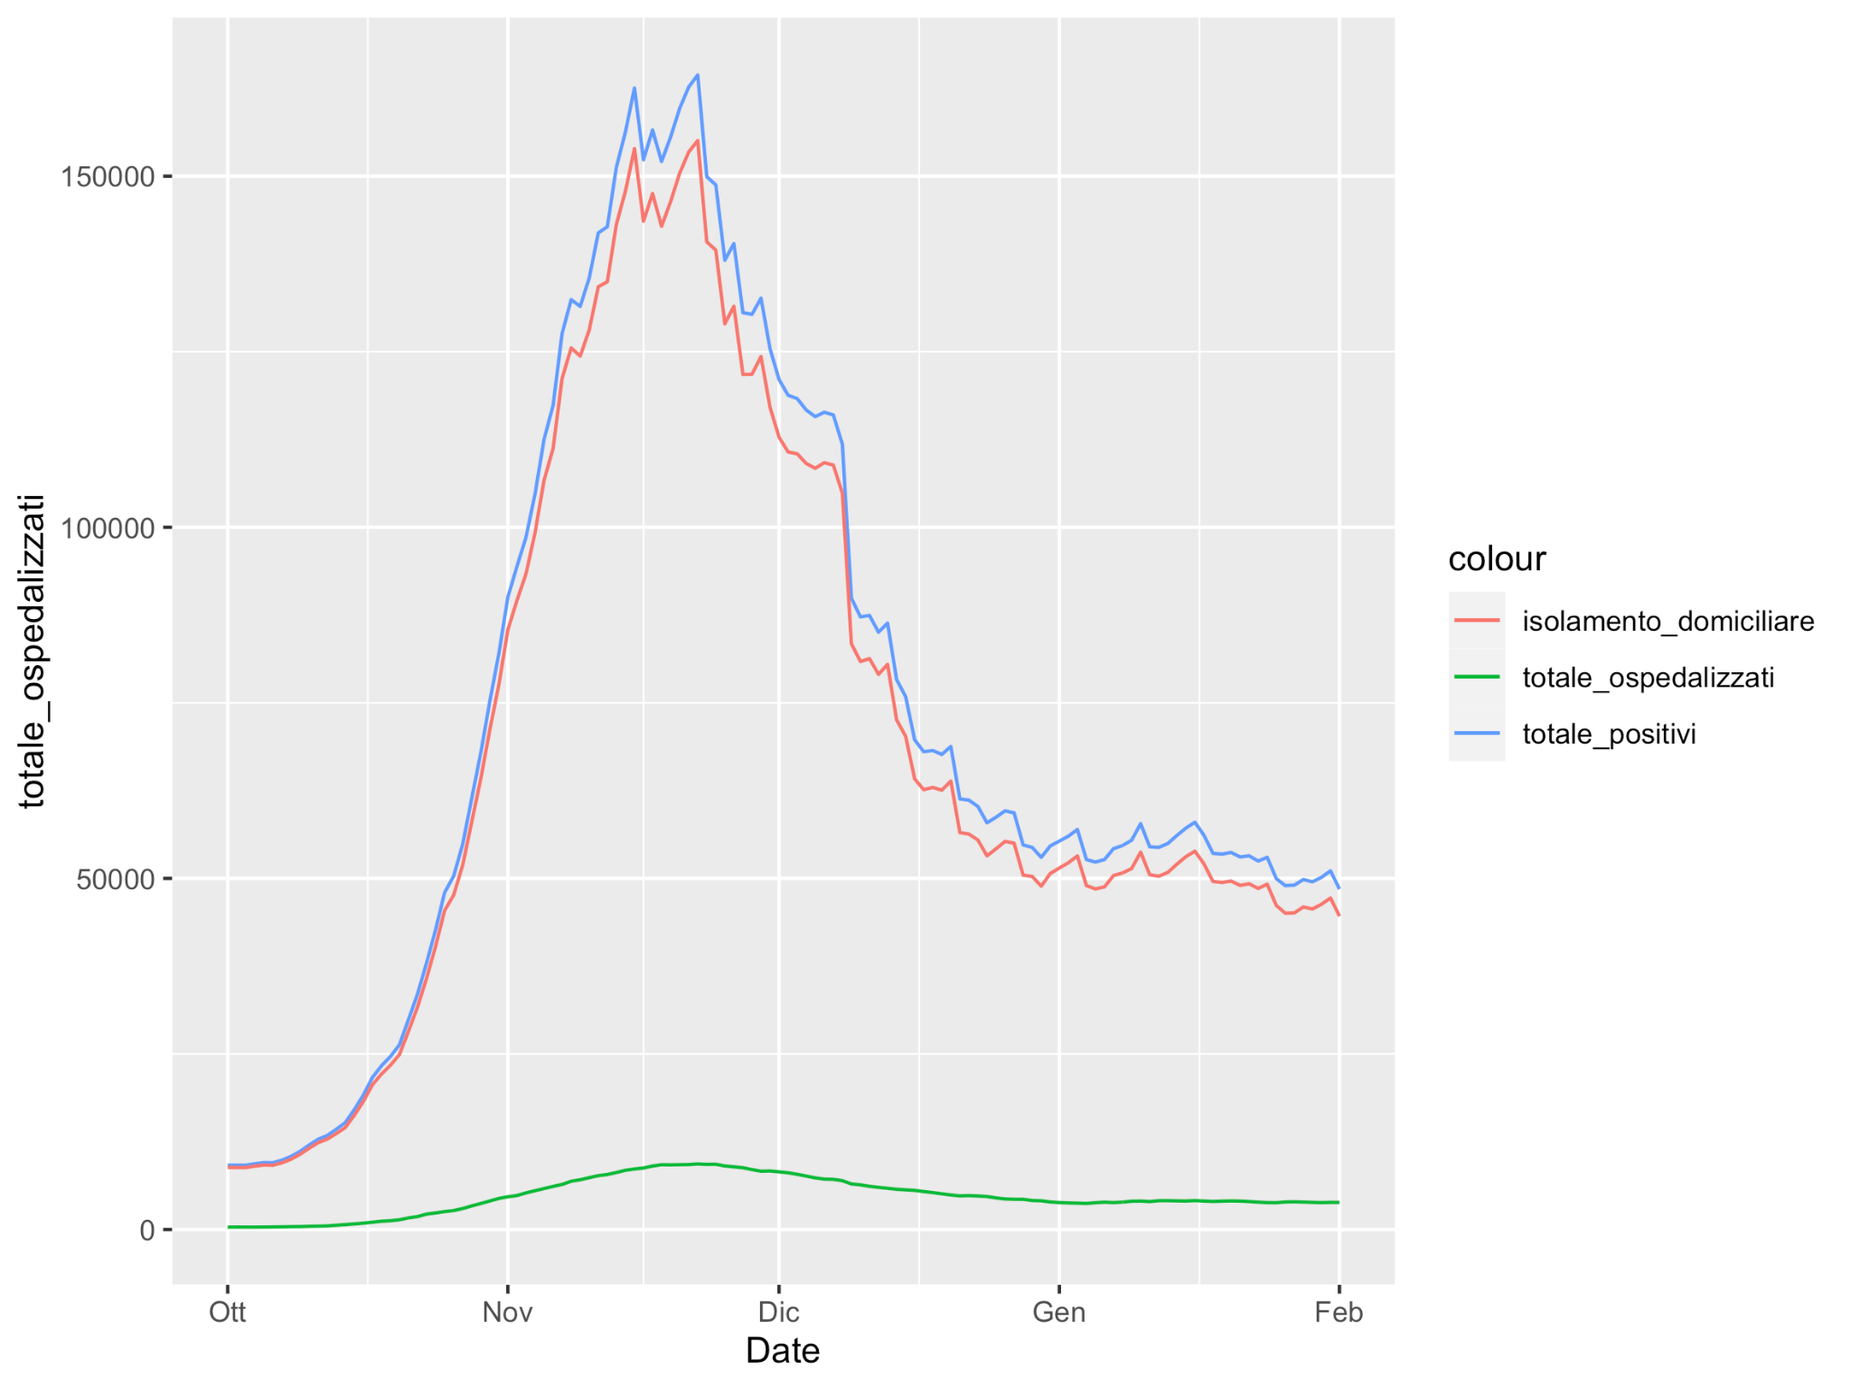
Exploratory Data Analysis
The total amount of hospitalized patients is the sum of intensive care and hospitalised patients with symptoms
The total amount of hospitalized patients is the difference between of total positive and home confinement

Slide 11
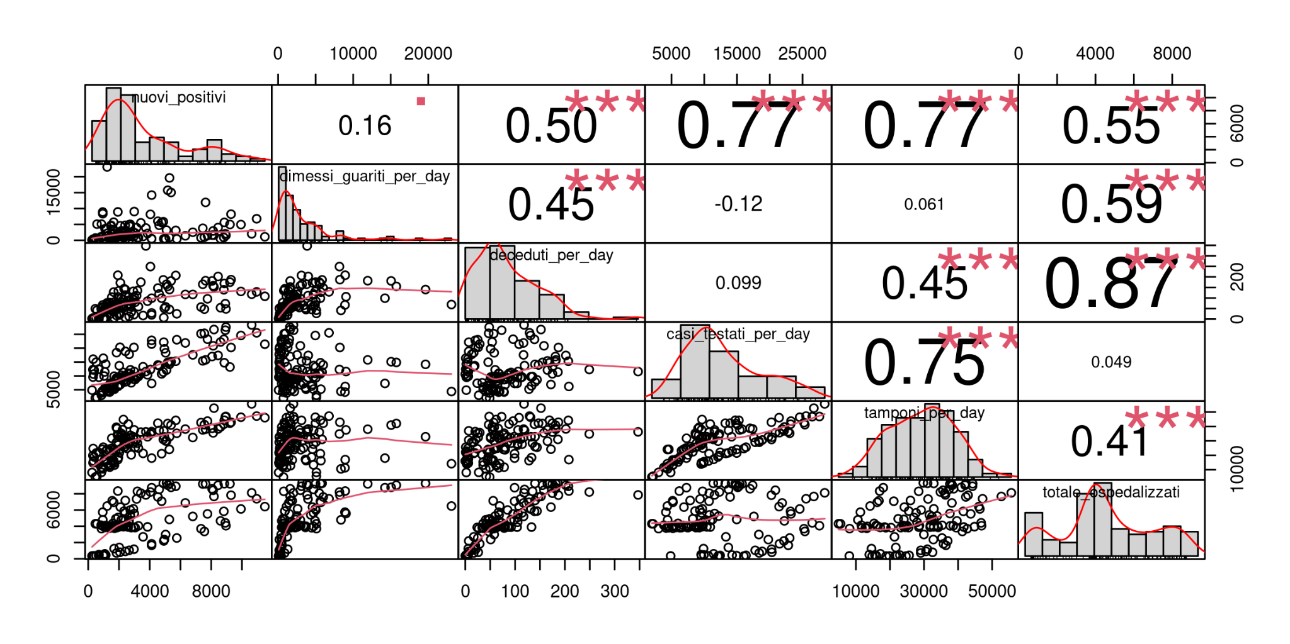
Exploratory Data Analysis

Slide 12
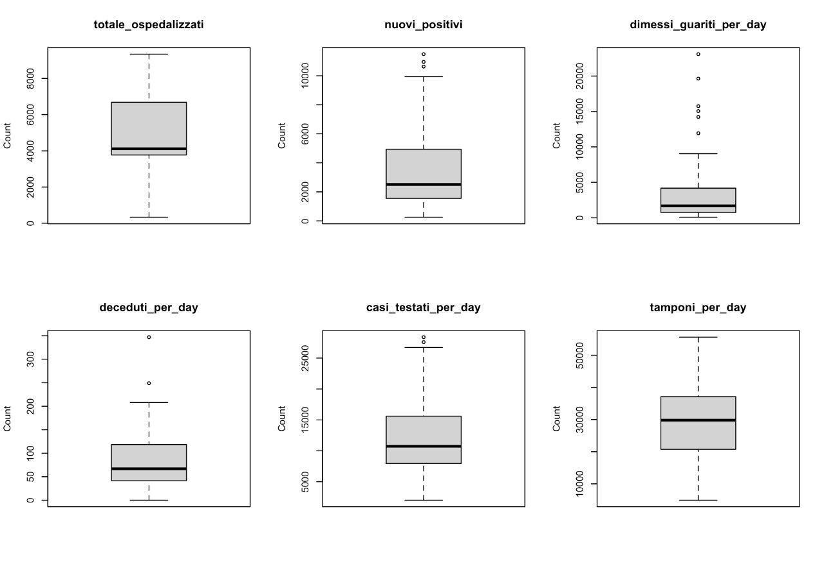
Exploratory Data Analysis
Boxplots of interesting variables to spot the outliers

Slide 13
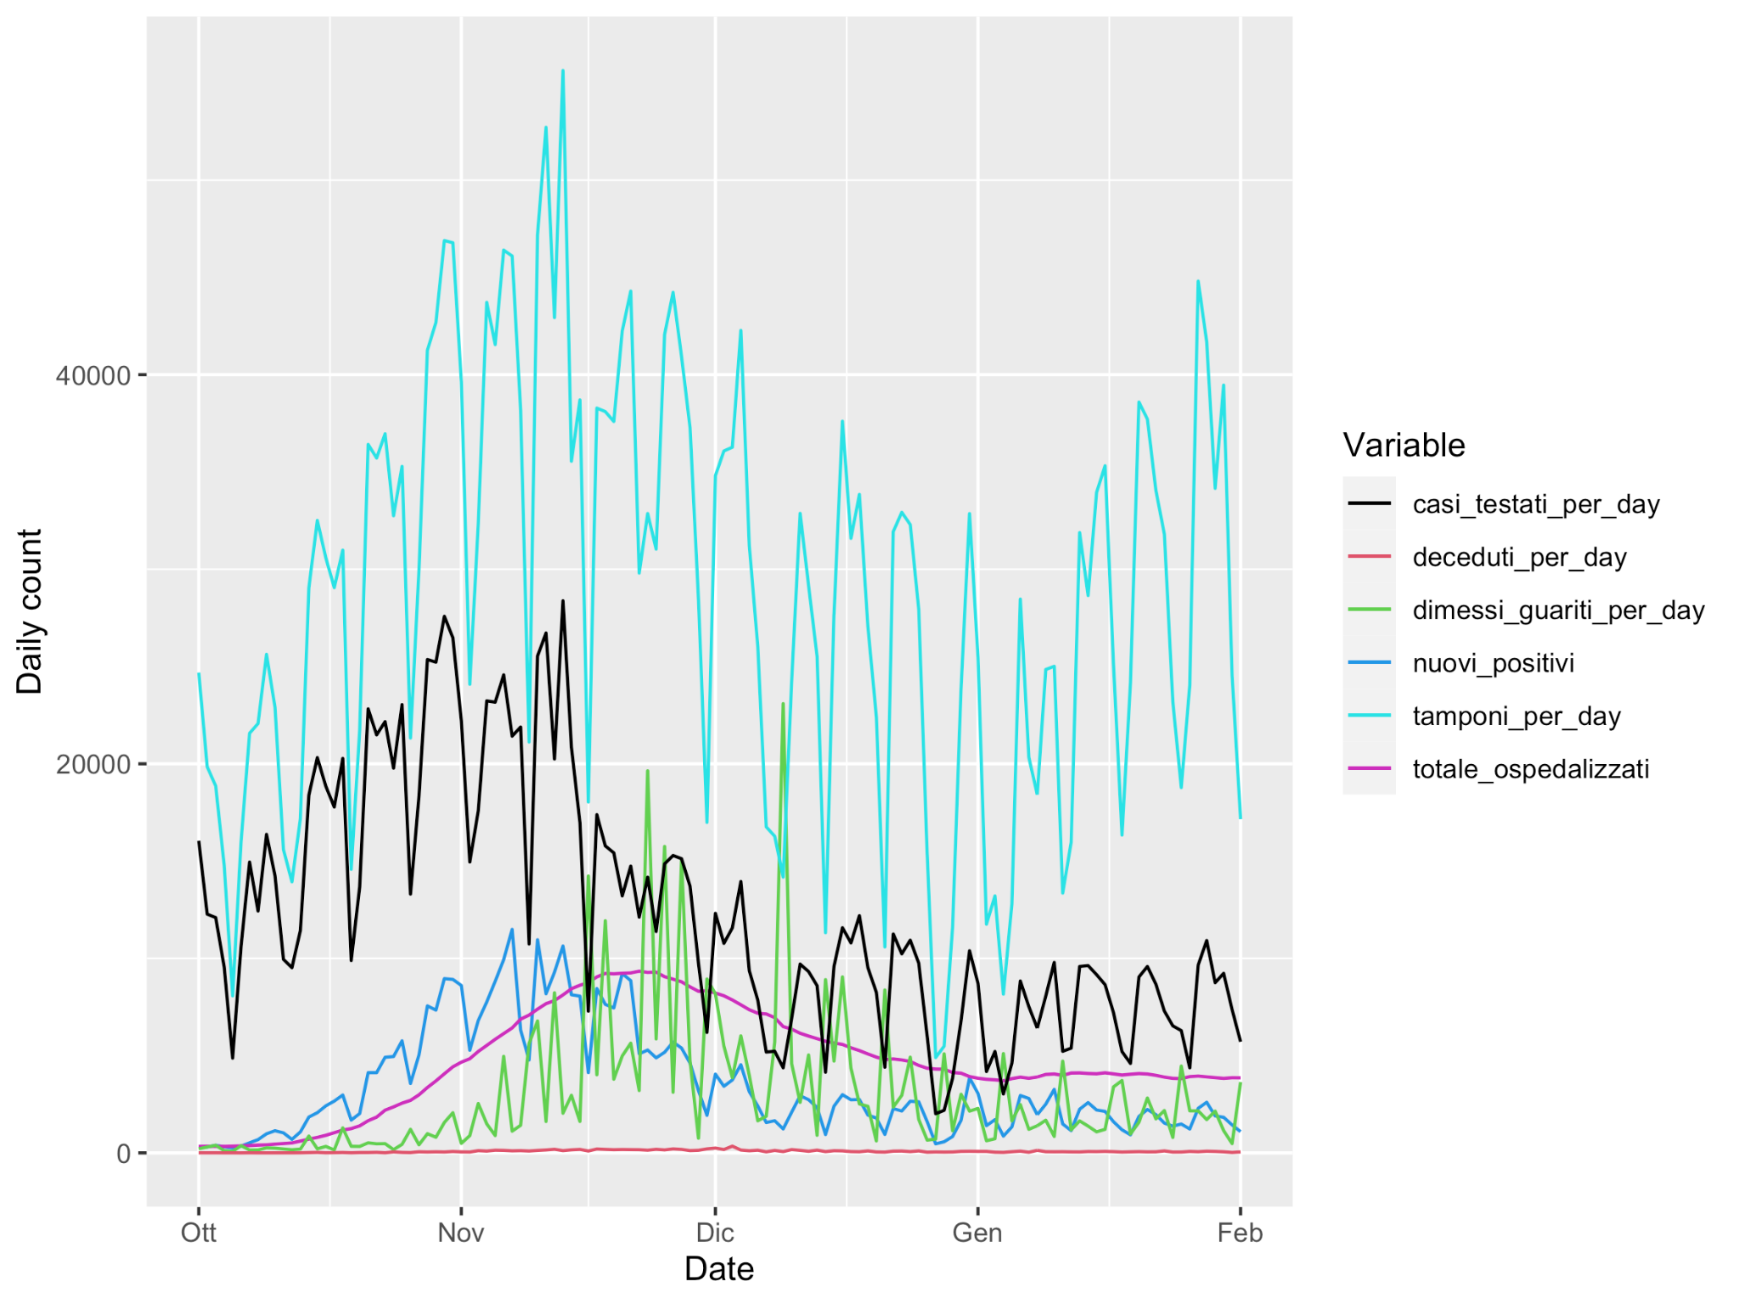
Exploratory Data Analysis
Daily counts of the interesting variables in Lombardia per day from the 1st October 2020 to the 1st February 2021

Slide 14
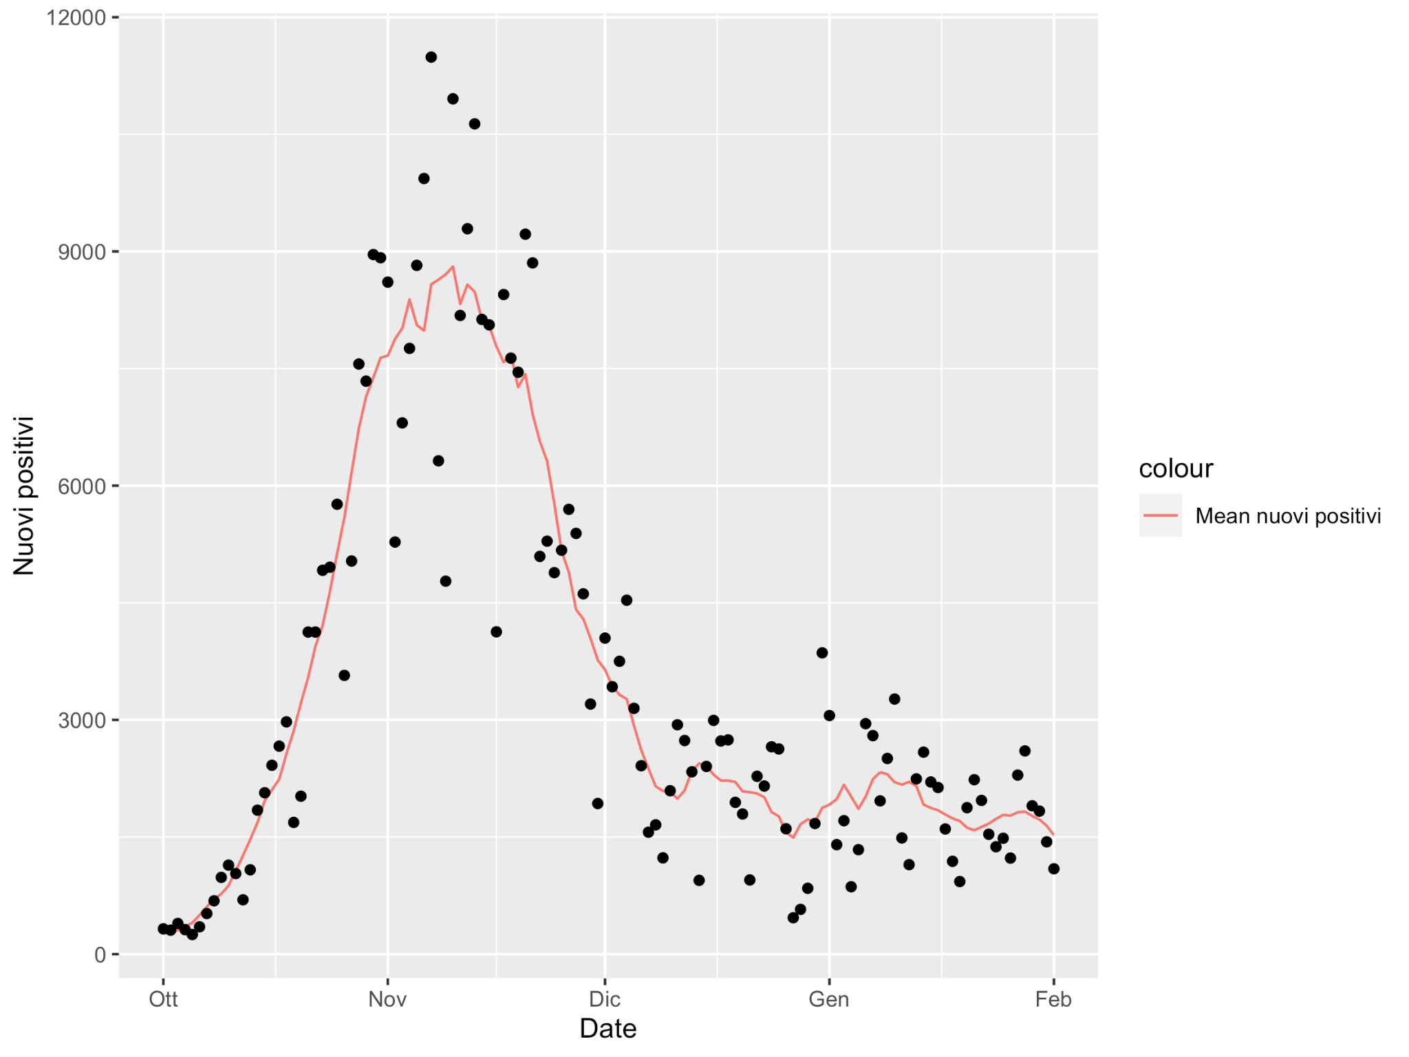
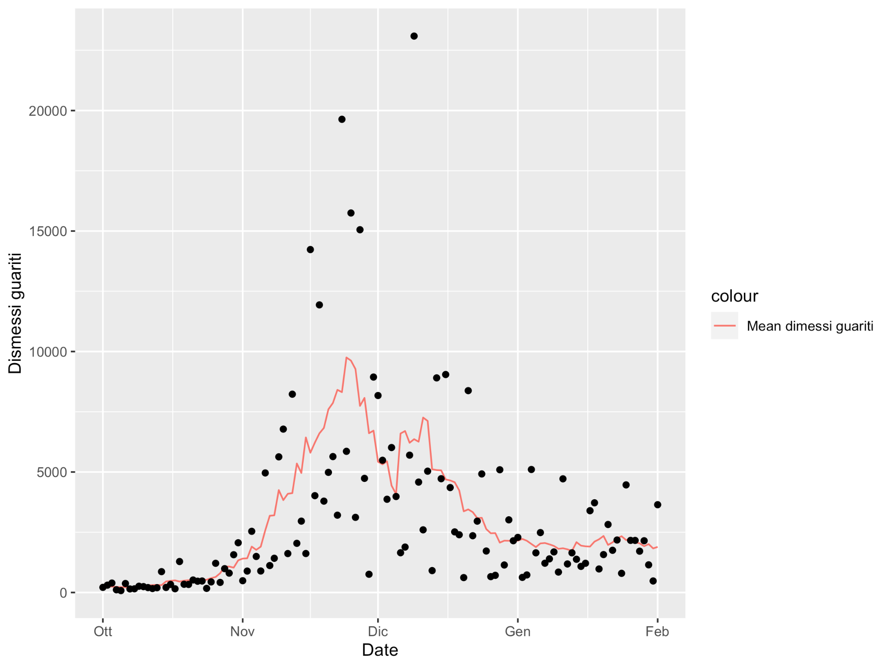
Exploratory Data Analysis
Moving average of the new amount of current positive and of the revored people per day in Lombardia per day from the 1st October 2020 to the 1st February 2021

Slide 15
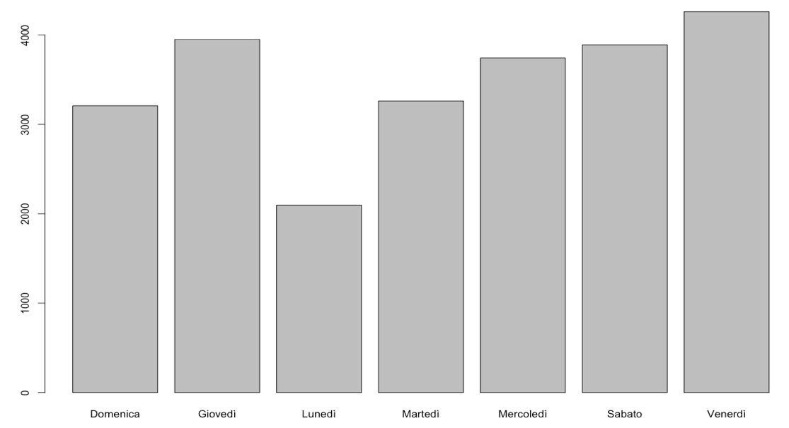
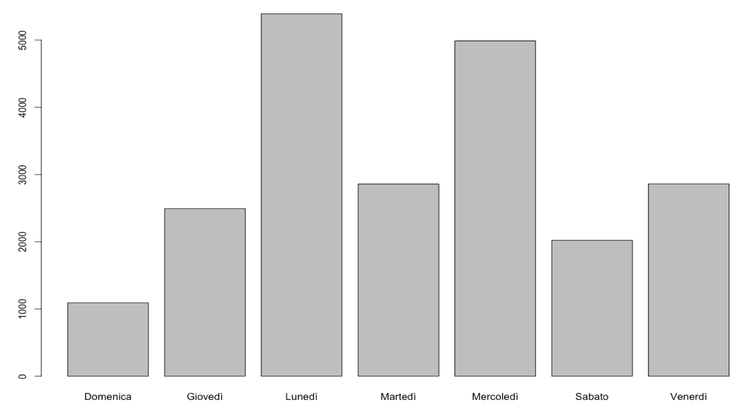
Exploratory Data Analysis
Mean of number of positive per day of the week
Mean of number of recovered per day of the week

Slide 16
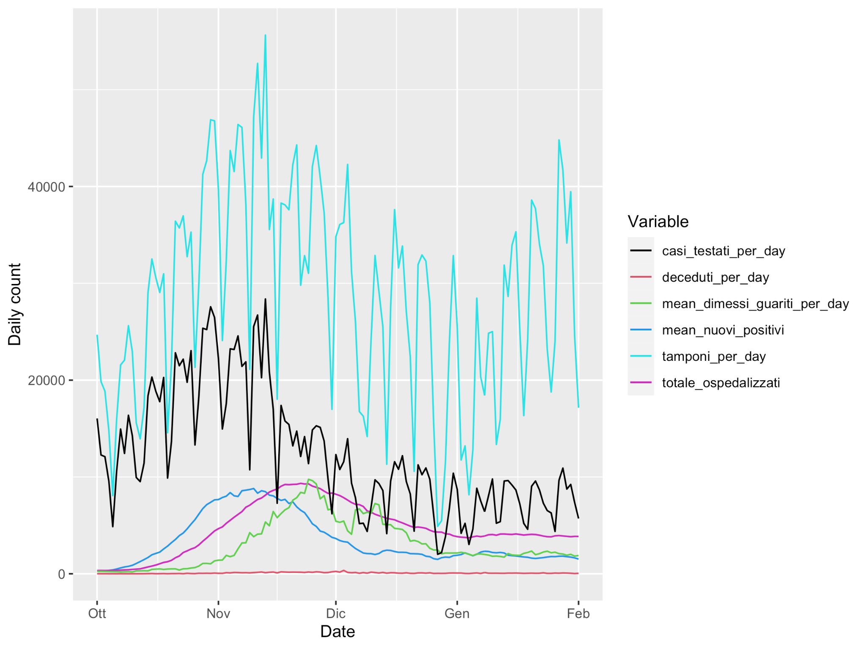
Exploratory Data Analysis

Slide 17
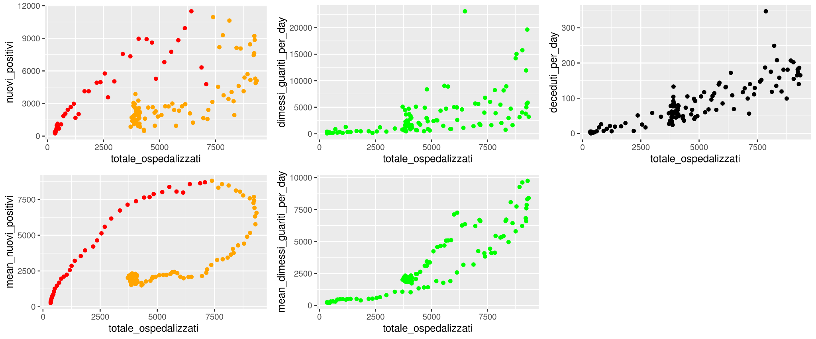
Exploratory Data Analysis
Scatterplots of interesting variables against the total number of hospitalised patients

Slide 18
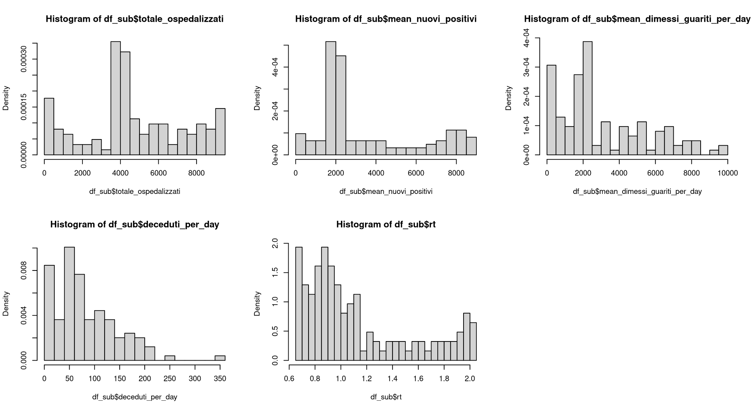
Exploratory Data Analysis

Slide 19
Model building - Linear model
Linear regression analysis is used to predict the value of a variable as the weighted sum of a set of independent variables with an individual error that follows a Gaussian distribution
Main assumptions:
Linearity
Homoscedasticity
Independence of the observations
Normality
Uncorrelated random components
Advantages:
Relatively simple
Easy-to-interpret mathematical formula that can generate predictions
Notes:
https://www.ibm.com/topics/linear-regression#:~:text=Linear%20regression%20analysis%20is%20used,is%20called%20the%20independent%20variable.
Linear relationship between the dependent variable and each independent variable and all observations should be independent
For each value of the independent variable, the distribution of the dependent variable must be normal.
The variance of the distribution of the dependent variable should be constant for all values of the independent variable.
data follow a normal distribution with a fixed variance.

Slide 20
Model building - Linear model
Adopting a forward selection approach
Occam’s razor criteria
Checking model goodness
usefulness of the overall model
R2
F-test
Significance test of single predictors
Residual Analysis
Check for multicollinearity (VIF)
Comparing alternative models
Adjusted R2
AIC
Anova (F-test)
Notes:
ANOVA testing whether the more complex model is significantly better at capturing the data than the simpler model. If the resulting p-value is sufficiently low (usually less than 0.05), we conclude that the more complex model is significantly better than the simpler model, and thus favor the more complex model. If the p-value is not sufficiently low (usually greater than 0.05), we should favor the simpler model.

Slide 21
Model building - Linear model
Linear Model | Adjusted R2 | AIC
totale_ospedalizzati ~ mean_nuovi_positivi | 0.3504 | 1899.841
totale_ospedalizzati ~ mean_dimessi_guariti_per_day | 0.8195 | 1741.051
totale_ospedalizzati ~ sqrt(mean_dimessi_guariti_per_day) | 0.8949 | 1673.957
totale_ospedalizzati ~ mean_nuovi_positivi + mean_dimessi_guariti_per_day | 0.9054 | 1661.962
totale_ospedalizzati ~ mean_nuovi_positivi + sqrt(mean_dimessi_guariti_per_day) | 0.9661 | 1534.753
totale_ospedalizzati ~ mean_nuovi_positivi + sqrt(mean_dimessi_guariti_per_day) + deceduti_per_day | 0.9725 | 1509.792
totale_ospedalizzati ~ mean_nuovi_positivi + sqrt(mean_dimessi_guariti_per_day) + deceduti_per_day + rt^2 | 0.9801 | 1470.266

Slide 22
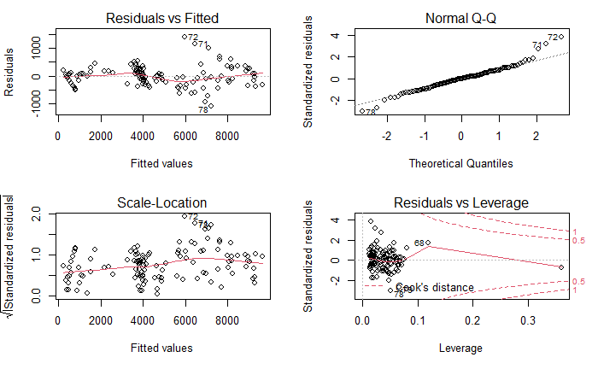
Model building - Linear model
totale_ospedalizzati ~ mean_nuovi_positivi + sqrt(mean_dimessi_guariti_per_day) + deceduti_per_day + rt^2
Notes:
Res vs fitted: check heteroscedasticity
normal q-q: check normality
res vs leverages: check outliers
rs vs vars: check linearity
https://towardsdatascience.com/linear-regression-modeling-and-assumptions-dcd7a201502a

Slide 23
Model building - GLM
GLM generalizes linear regression by allowing the linear model to be related to the response variable via a link function and by allowing the magnitude of the variance of each measurement to be a function of its predicted value
Main assumptions:
Independence of the observations
Response variable can be non-normal (discrete distributions and distribution with finite support are allowed) but shall typically assume a distribution from an exponential family
Non-linearity between the response variable and the explanatory variables allowed but linearity between the transformed expected response and the explanatory variable in terms of the link function is required
Heteroscedasticity is allowed
Advantages:
Relatively easy to interpret and allows a clear understanding of how each of the predictors are influencing the outcome
All the inference tools are valid
Notes:
independence of the observations
Normality of the response variable is not required but it typically assumes a distribution from an exponential family (e.g. binomial, Poisson, multinomial, normal, etc.).
Linearity between the response variable and the explanatory variables can be relaxed
Linearity between the transformed expected response and the explanatory variable in terms of the link function is required

Slide 24
Model building - GLM
Our response variable is discrete and has positive support
Suitable distribution selected:
Poisson
Gamma
Adopting a stepwise backward selection approach
Checking model goodness
usefulness of the overall model
Residual deviance
Significance test of single predictors
Comparing alternative models
AIC
Anova (Chisq-test)
Deviance explained
Notes:
ndependence of the observations
Normality of the response variable is not required but it typically assumes a distribution from an exponential family (e.g. binomial, Poisson, multinomial, normal, etc.).
Linearity between the response variable and the explanatory variables can be relaxed
Linearity between the transformed expected response and the explanatory variable in terms of the link function is required

Slide 25
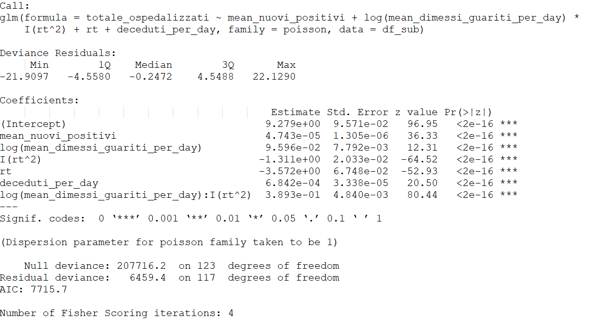
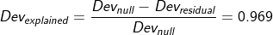
Model building - GLM - Poisson
Notes:
You cannot calculate sums of squares from a generalized linear model. Instead GLMs are assessed in terms of changes in the deviance explained. Deviance values are calculated based on the (log) likelihoods of three models: the proposed model, a null model, and a saturated model (which has one parameter per data point). A generalized linear model can then be characterized in terms of two types of deviance:
The null deviance, which is a measure of the overall variability in the response variable:
The residual deviance, which is a measure of the variability in the response variable that remains unexplained by the proposed model
The comparison of two models using analysis of variance is based on the difference in the residual deviance of the models. This deviance difference can be compared to a chi-squared distribution to obtain a P value.
When we ran linear models, we used the coefficient of determination, or R2 to assess how much of the variability in our response variable is explained by a given model. R2 is based on the sums of squares of our model, and so cannot be calculated for GLMs. Instead, we can calculate the analogous “deviance explained” by our model
If data follow a Poisson distribution, then the mean of the distribution is equal to the variance. Accordingly, a Poisson distribution is represented by just one parameter λ, which describes both the mean and the variance of the distribution. We can get an indication of whether a model is over-dispersed by inspecting the model summary. As a rule of thumb, if the response variable conforms to a true Poisson distribution, we expect the residual deviance to be approximately equal to the residual degrees of freedom. If the deviance is much greater than the degrees of freedom, this indicates over-dispersion.

Slide 26
Model building - GLM - Poisson
As a rule of thumb:
Residual deviance >>> degrees of freedom → Overdispersion
Notes:
You cannot calculate sums of squares from a generalized linear model. Instead GLMs are assessed in terms of changes in the deviance explained. Deviance values are calculated based on the (log) likelihoods of three models: the proposed model, a null model, and a saturated model (which has one parameter per data point). A generalized linear model can then be characterized in terms of two types of deviance:
The null deviance, which is a measure of the overall variability in the response variable:
The residual deviance, which is a measure of the variability in the response variable that remains unexplained by the proposed model
The comparison of two models using analysis of variance is based on the difference in the residual deviance of the models. This deviance difference can be compared to a chi-squared distribution to obtain a P value.
When we ran linear models, we used the coefficient of determination, or R2 to assess how much of the variability in our response variable is explained by a given model. R2 is based on the sums of squares of our model, and so cannot be calculated for GLMs. Instead, we can calculate the analogous “deviance explained” by our model
If data follow a Poisson distribution, then the mean of the distribution is equal to the variance. Accordingly, a Poisson distribution is represented by just one parameter λ, which describes both the mean and the variance of the distribution. We can get an indication of whether a model is over-dispersed by inspecting the model summary. As a rule of thumb, if the response variable conforms to a true Poisson distribution, we expect the residual deviance to be approximately equal to the residual degrees of freedom. If the deviance is much greater than the degrees of freedom, this indicates over-dispersion.

Slide 27
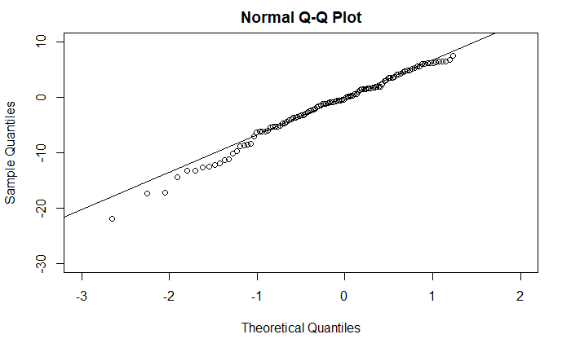
Model building - GLM - Poisson
Confirming overdispersion:
# Overdispersion test
dispersion ratio = 53.759
Pearson's Chi-Squared = 6289.759
p-value = < 0.001
Overdispersion detected.
Notes:
The approximate normality in the deviance residuals allows to evaluate how well satisfied the assumption of the response distribution is. asymptotic distribution.

Slide 28
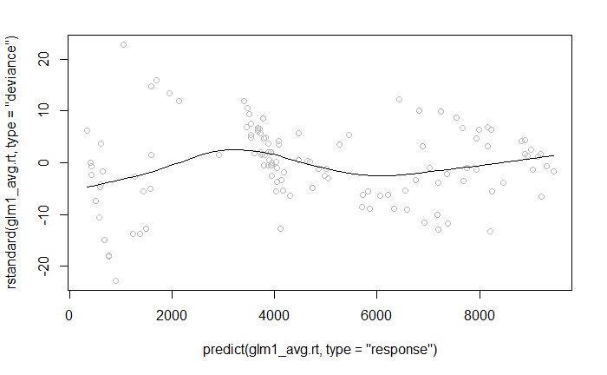
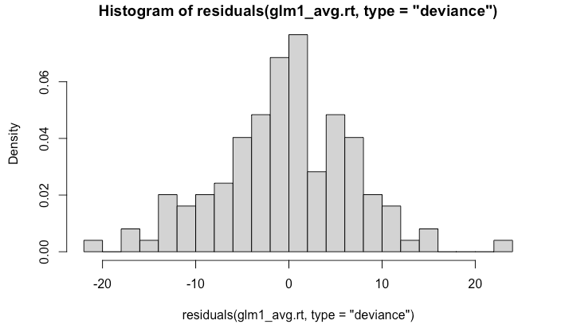
Model building - GLM - Poisson
Residuals versus fitted values
Histogram of the residuals
Notes:
https://bookdown.org/egarpor/PM-UC3M/glm-diagnostics.html

Slide 29
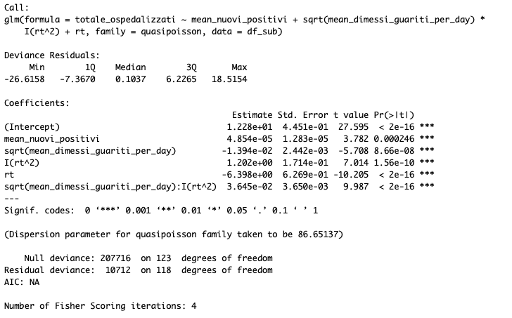
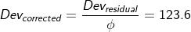
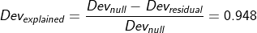
Model building - GLM - QuasiPoisson
Notes:
ndependence of the observations
Normality of the response variable is not required but it typically assumes a distribution from an exponential family (e.g. binomial, Poisson, multinomial, normal, etc.).
Linearity between the response variable and the explanatory variables can be relaxed
Linearity between the transformed expected response and the explanatory variable in terms of the link function is required
Homoscedasticity can be relaxed

Slide 30
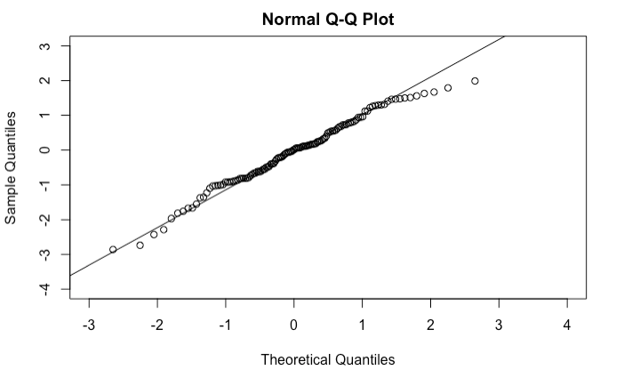
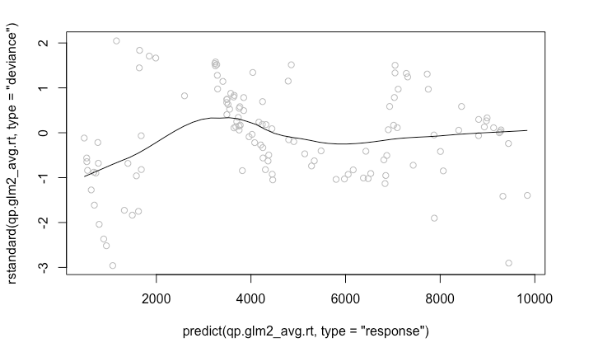
Model building - GLM - QuasiPoisson
Response distribution
Residuals versus fitted values
Notes:
ndependence of the observations
Normality of the response variable is not required but it typically assumes a distribution from an exponential family (e.g. binomial, Poisson, multinomial, normal, etc.).
Linearity between the response variable and the explanatory variables can be relaxed
Linearity between the transformed expected response and the explanatory variable in terms of the link function is required
Homoscedasticity can be relaxed

Slide 31
Model building - GLM - QuasiPoisson
Notes:
ndependence of the observations
Normality of the response variable is not required but it typically assumes a distribution from an exponential family (e.g. binomial, Poisson, multinomial, normal, etc.).
Linearity between the response variable and the explanatory variables can be relaxed
Linearity between the transformed expected response and the explanatory variable in terms of the link function is required
Homoscedasticity can be relaxed

Slide 32
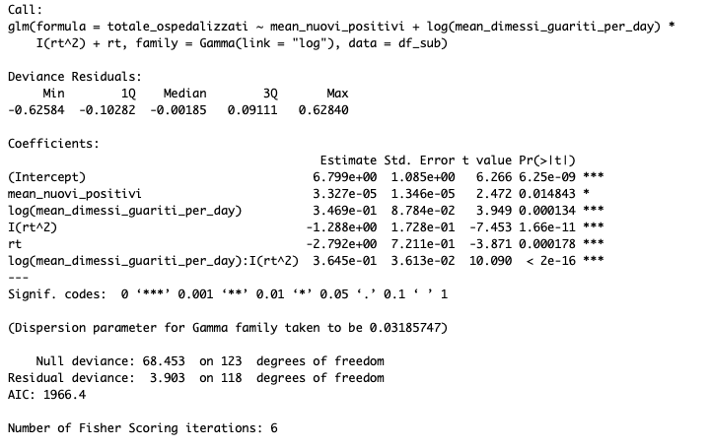
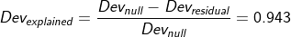
Model building - GLM - Gamma
Notes:
ndependence of the observations
Normality of the response variable is not required but it typically assumes a distribution from an exponential family (e.g. binomial, Poisson, multinomial, normal, etc.).
Linearity between the response variable and the explanatory variables can be relaxed
Linearity between the transformed expected response and the explanatory variable in terms of the link function is required
Homoscedasticity can be relaxed

Slide 33
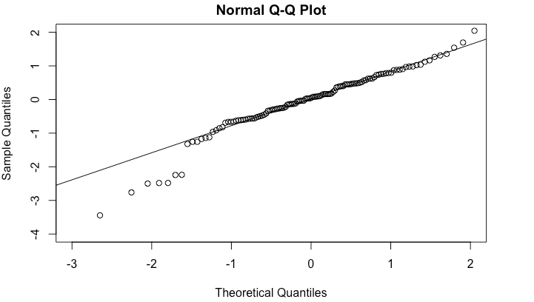
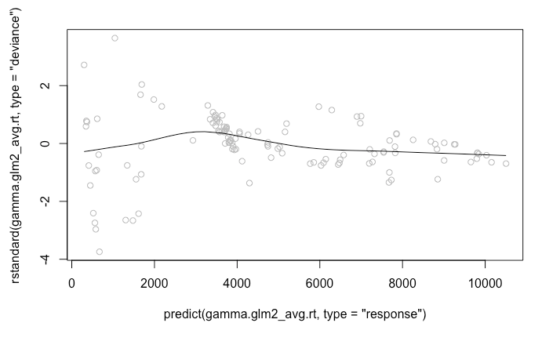
Model building - GLM - Gamma
Response distribution
Residuals versus fitted values
Notes:
ndependence of the observations
Normality of the response variable is not required but it typically assumes a distribution from an exponential family (e.g. binomial, Poisson, multinomial, normal, etc.).
Linearity between the response variable and the explanatory variables can be relaxed
Linearity between the transformed expected response and the explanatory variable in terms of the link function is required
Homoscedasticity can be relaxed

Slide 34
Model building - GLM - Gamma
Notes:
ndependence of the observations
Normality of the response variable is not required but it typically assumes a distribution from an exponential family (e.g. binomial, Poisson, multinomial, normal, etc.).
Linearity between the response variable and the explanatory variables can be relaxed
Linearity between the transformed expected response and the explanatory variable in terms of the link function is required
Homoscedasticity can be relaxed

Slide 35
Model building - GAM
GAMs are a semi-parametric extensions of GLMs that assume that the outcome can be modeled by a sum of arbitrary smooth functions of each feature
Main assumptions:
Independence of the observations
….
Advantages:
GAMs are very flexible, and provide excellent fit for both linear and nonlinear relationships
Very good for prediction
Notes:
GAM is an additive modeling technique where the impact of the predictive variables is captured through smooth functions which—depending on the underlying patterns in the data—can be nonlinear

Slide 36
Model building - GAM
Our response variable is discrete and has positive support
Suitable distribution choices can be:
Poisson
Gamma
Checking model goodness
usefulness of the overall model
Residual deviance
Significance test of single predictors
Comparing alternative models
AIC
Deviance explained
Adjusted R2
Notes:
Deviance is defined in the same way as in GLMs. The comparison of nested GAMs by substracting deviances does not necessarily follow a χ 2 distribution, even asymptotically. However, one can use the chi-square distribution as sort of a reference for assessing fits.
minimizing residual deviance (goodness of fit) while maximizing parsimony (lowest possible degrees of freedom). Since the model fit is based on deviance/likelihood, fitted models are directly comparable with GLMs using likelihood techniques (like AIC) or classical tests based on model deviance (Chi-squared or F tests, depending on the error structure).

Slide 37
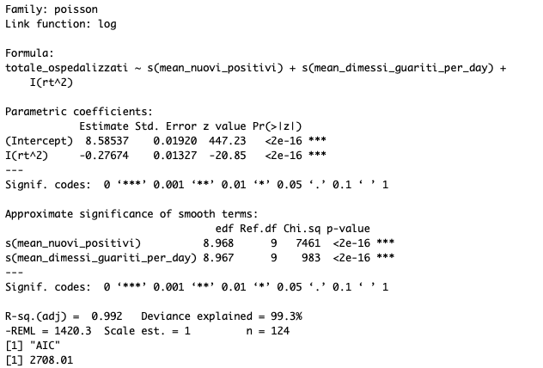
Model building - GAM - Poisson
Notes:
If the model mean-variance relationship is correct then scaled residuals should have roughly constant variance.

Slide 38
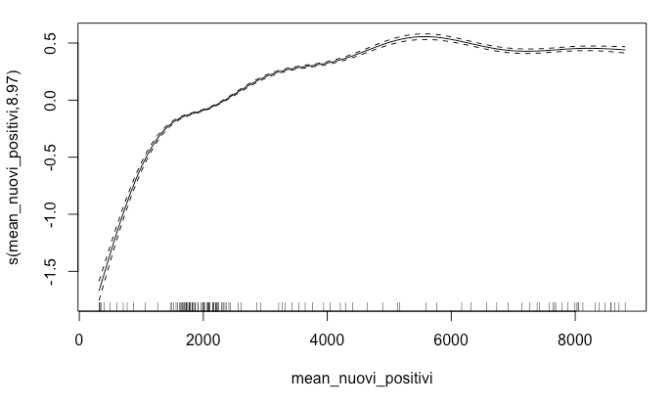
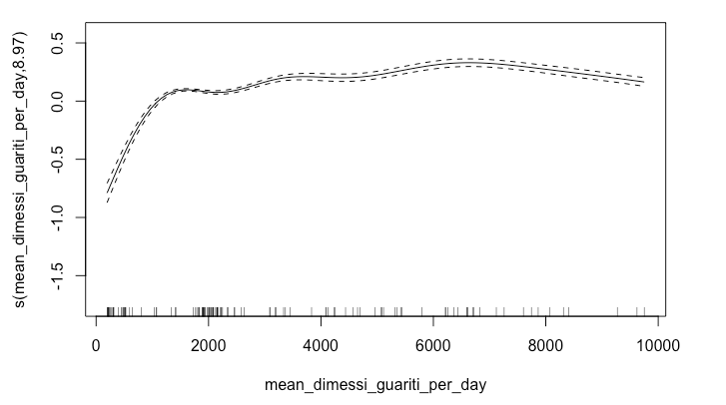
Model building - GAM - Poisson

Slide 39
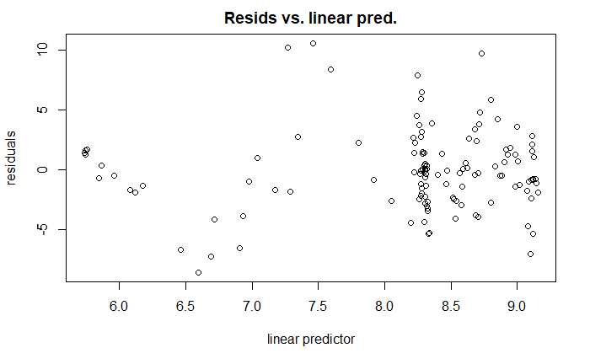
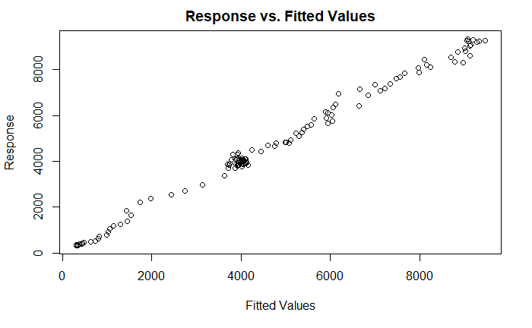
Model building - GAM - Poisson

Slide 40
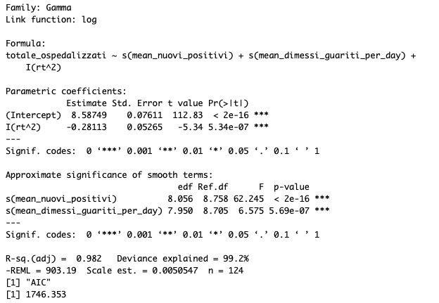
Model building - GAM - Gamma
Notes:
ndependence of the observations
Normality of the response variable is not required but it typically assumes a distribution from an exponential family (e.g. binomial, Poisson, multinomial, normal, etc.).
Linearity between the response variable and the explanatory variables can be relaxed
Linearity between the transformed expected response and the explanatory variable in terms of the link function is required

Slide 41
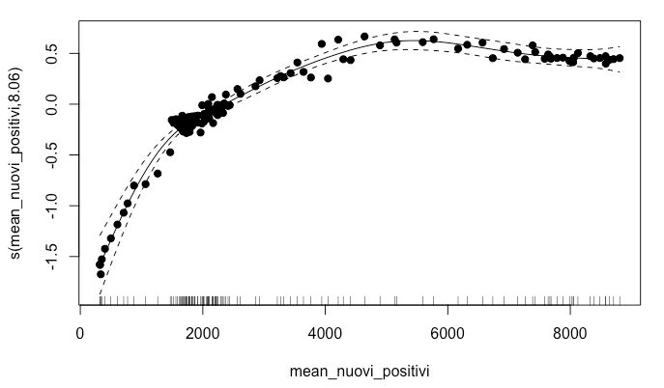
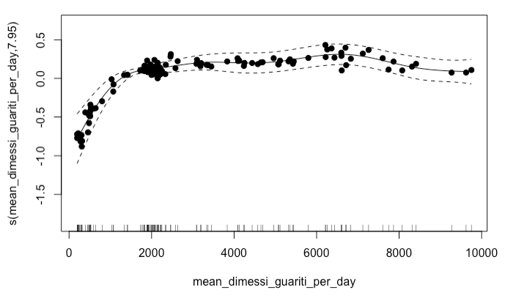
Model building - GAM - Gamma
Notes:
ndependence of the observations
Normality of the response variable is not required but it typically assumes a distribution from an exponential family (e.g. binomial, Poisson, multinomial, normal, etc.).
Linearity between the response variable and the explanatory variables can be relaxed
Linearity between the transformed expected response and the explanatory variable in terms of the link function is required

Slide 42
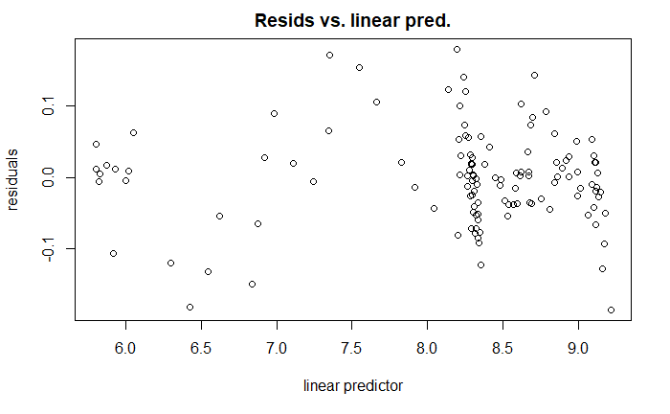
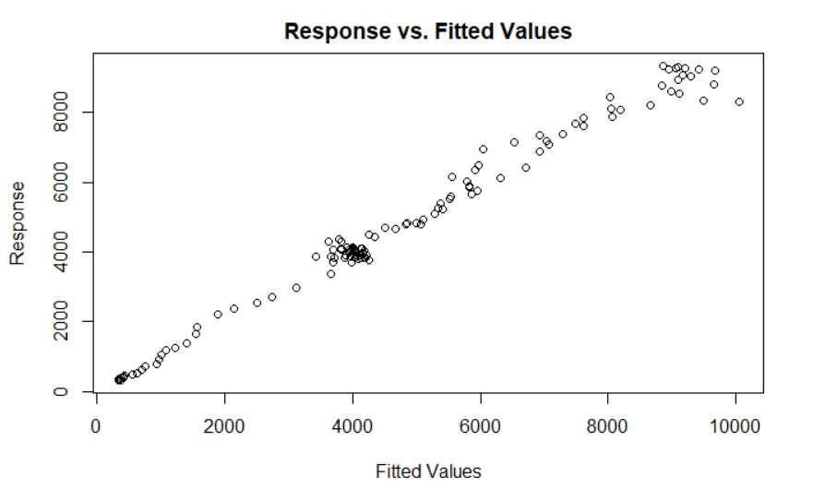
Model building - GAM - Gamma

Slide 43
Model selection - GLM / GAM
GLM Models | Deviance explained | AIC
totale_ospedalizzati ~ mean_nuovi_positivi + log(mean_dimessi_guariti_per_day)*I(rt^2) + rt + deceduti_per_day, family = poisson | 0.969 | 7715.7
totale_ospedalizzati ~ mean_nuovi_positivi+ sqrt(mean_dimessi_guariti_per_day)*I(rt^2) + rt, quasipoisson | 0.948 | NA
totale_ospedalizzati ~ mean_nuovi_positivi + log(mean_dimessi_guariti_per_day) * I(rt^2) + rt, family = Gamma(link = "log") | 0.943 | 1966.4
GAM Models | Adjusted R2 | AIC
totale_ospedalizzati ~ s(mean_nuovi_positivi) + s(mean_dimessi_guariti_per_day), family = poisson(link = log) | 0.992 | 2708.01
totale_ospedalizzati ~ s(mean_nuovi_positivi) + s(mean_dimessi_guariti_per_day) +I(rt^2), family = Gamma(link = log) | 0.982 | 1746.353

Slide 44
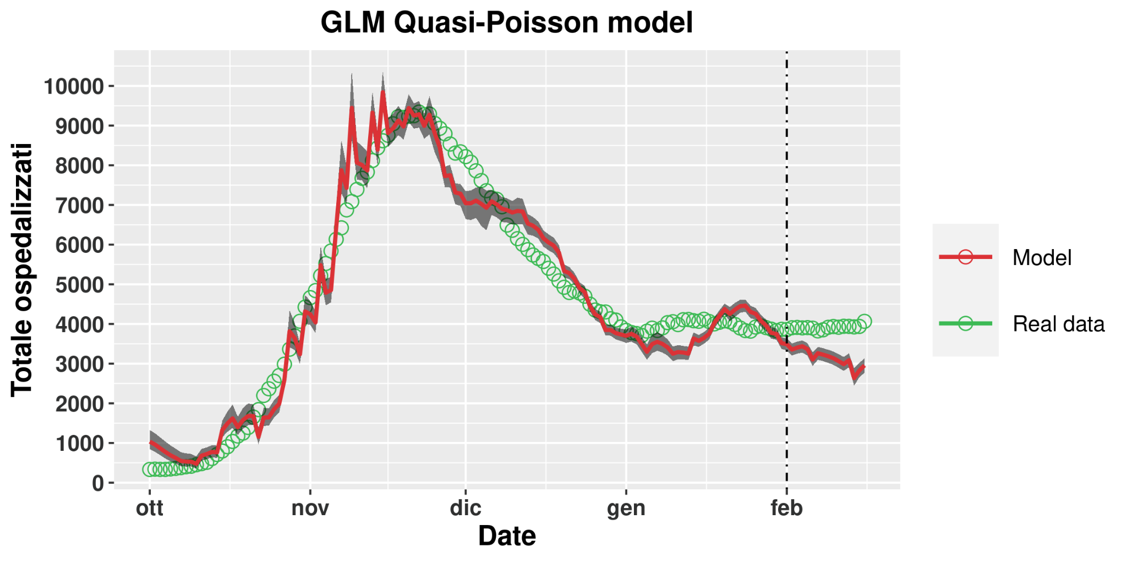
Model Prediction

Slide 45
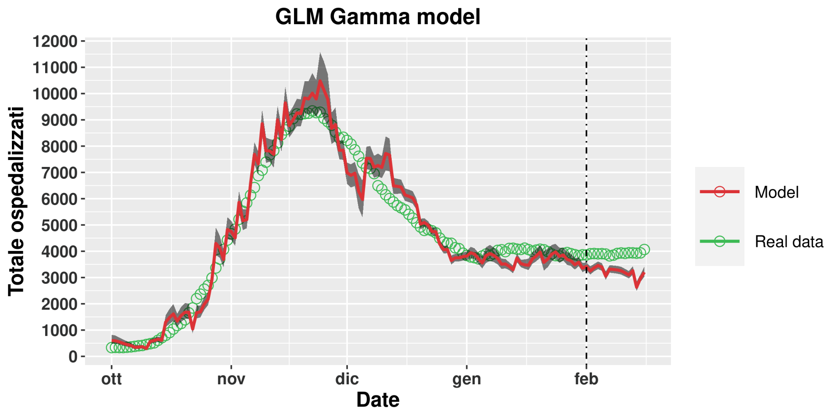
Model Prediction

Slide 46
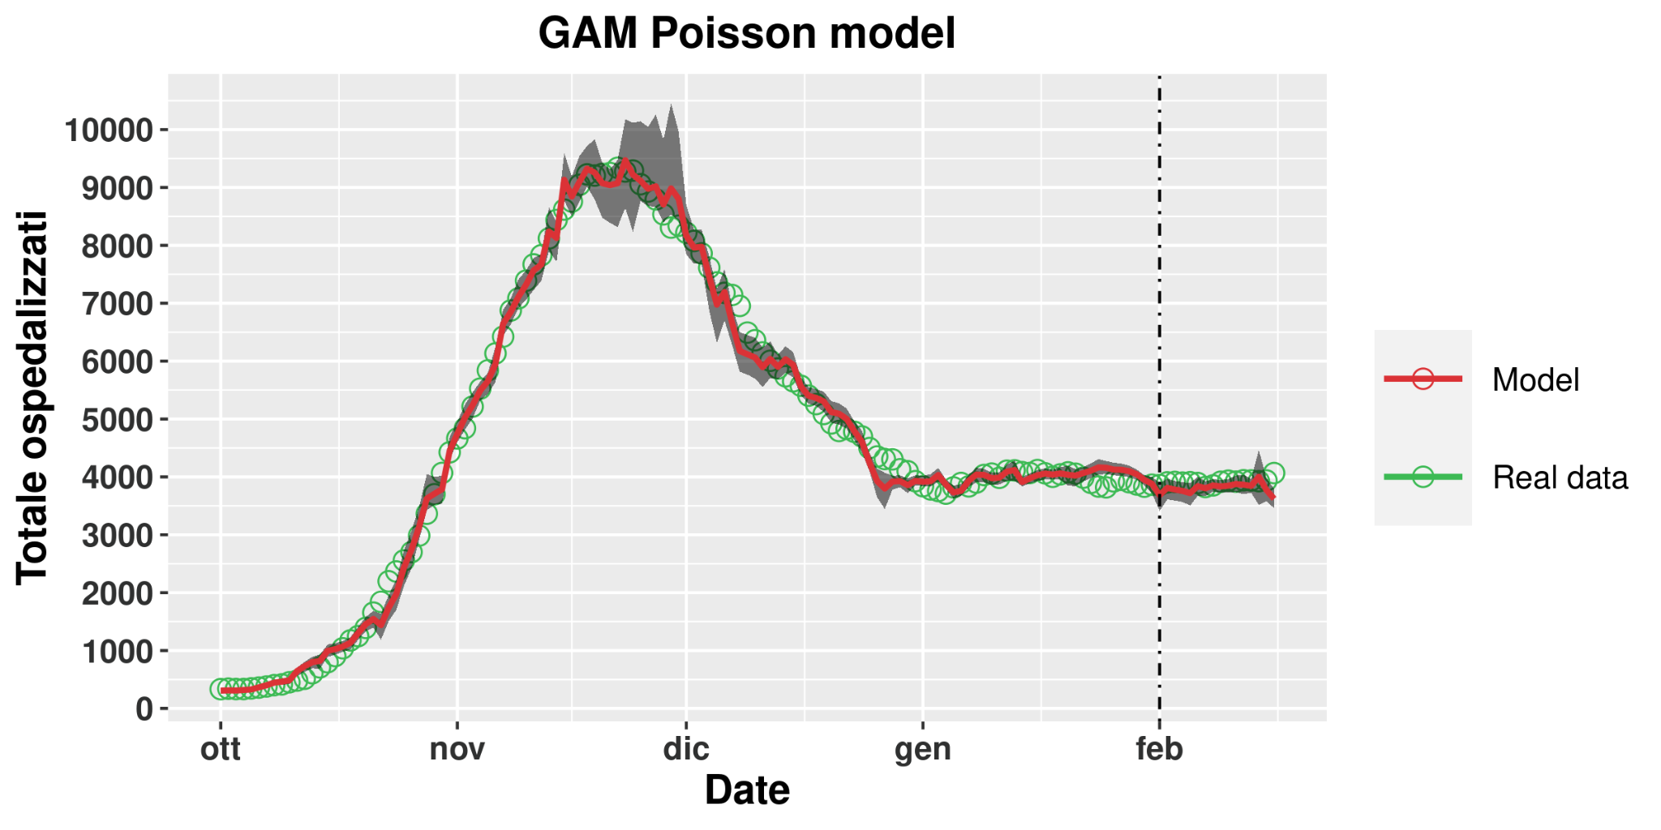
Model Prediction

Slide 47
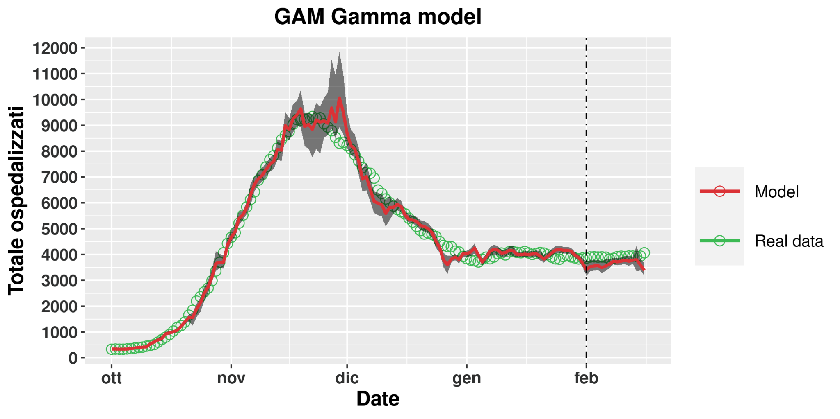
Model Prediction

Slide 48
Model prediction
GLM Models | Deviance explained | AIC | RMSE
totale_ospedalizzati ~ mean_nuovi_positivi + log(mean_dimessi_guariti_per_day)*I(rt^2) + rt + deceduti_per_day, family = poisson | 0.969 | 7715.7 | 658.8
totale_ospedalizzati ~ mean_nuovi_positivi+ sqrt(mean_dimessi_guariti_per_day)*I(rt^2) + rt, family = quasipoisson | 0.948 | NA | 819.2
totale_ospedalizzati ~ mean_nuovi_positivi + log(mean_dimessi_guariti_per_day) * I(rt^2) + rt, family = Gamma(link = "log") | 0.943 | 1966.4 | 746.6
GAM Models | Adjusted R2 | AIC | RMSE
totale_ospedalizzati ~ s(mean_nuovi_positivi) + s(mean_dimessi_guariti_per_day), family = poisson(link = log) | 0.992 | 2708.01 | 152.1
totale_ospedalizzati ~ s(mean_nuovi_positivi) + s(mean_dimessi_guariti_per_day) +I(rt^2), family = Gamma(link = log) | 0.982 | 1746.353 | 313.3

